Slide 1
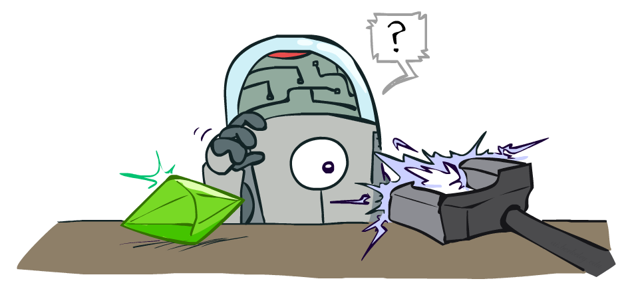
Artificial Intelligence
Reinforcement Learning
Notes:
Please retain proper attribution, including the reference to ai.berkeley.edu. Thanks!

Slide 2
Overview
Supervised Learning: Immediate feedback (labels provided for every input).
Unsupervised Learning: No feedback (no labels provided).
Reinforcement Learning: Delayed scalar feedback (a number called reward).
RL deals with agents that must sense & act upon their environment.
This is combines classical AI and machine learning techniques.
It the most comprehensive problem setting.
Examples:
A robot cleaning my room and recharging its battery
Robot-soccer
Learning how to fly a helicopter
and so on

Slide 3
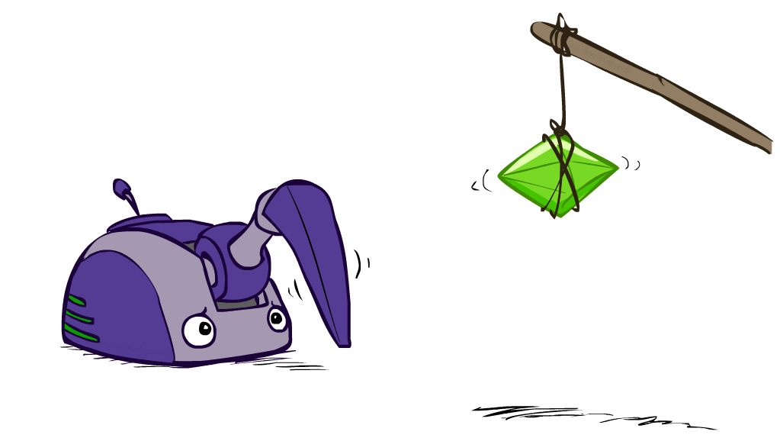
Reinforcement Learning

Slide 4
Reinforcement Learning
Agent
State: s
Reward: r
Actions: a
Environment
Basic idea:
Receive feedback in the form of rewards
Agent’s utility is defined by the reward function
Must (learn to) act so as to maximize expected rewards
All learning is based on observed samples of outcomes!
Notes:
Show robot-soccer learning to walk videos (UT Austin):
? Show snake robot:

Slide 5
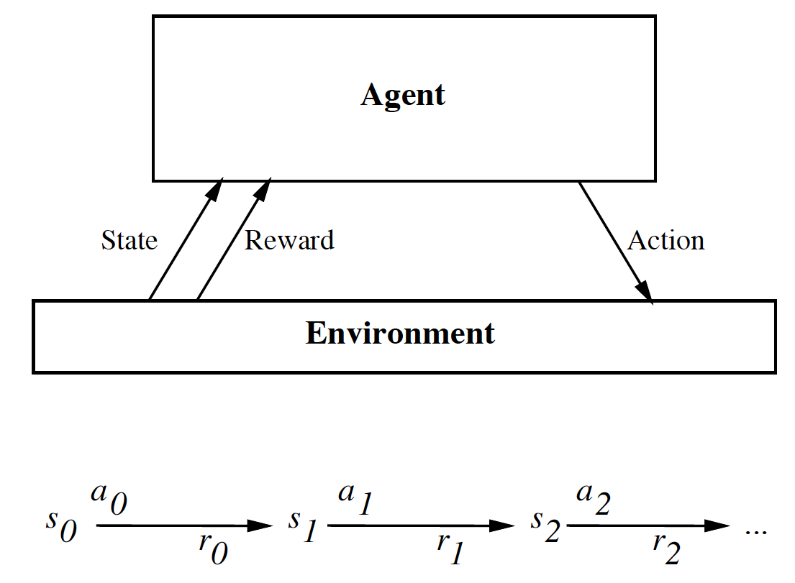
The Big Picture
Your action influences the state of the world which determines its reward

Slide 6
Complications
The outcome of your actions may be uncertain
You may not be able to perfectly sense the state of the world
The reward may be stochastic.
Reward is delayed (i.e. finding food in a maze)
You may have no clue (model) about how the world responds to your actions.
You may have no clue (model) of how rewards are being paid off.
The world may change while you try to learn it
How much time do you need to explore uncharted territory before you
exploit what you have learned?

Slide 7
The Task
To learn an optimal policy that maps states of the world to actions of the agent.
I.e., if this patch of room is dirty, I clean it. If my battery is empty, I recharge it.
What is it that the agent tries to optimize?
Answer: the total future discounted reward:
Note: immediate reward is worth more than future reward.

Slide 8
Value Function
Let’s say we have access to the optimal value function that computes the
total future discounted reward
What would be the optimal policy ?
Answer: we choose the action that maximizes:
We assume that we know what the reward will be if we perform action “a” in
state “s”:
We also assume we know what the next state of the world will be if we perform
action “a” in state “s”:

Slide 9
Example I
Consider some complicated graph, and we would like to find the shortest
path from a node Si to a goal node G.
Traversing an edge will cost you “length edge” dollars.
The value function encodes the total remaining
distance to the goal node from any node s, i.e.
V(s) = “1 / distance” to goal from s.
If you know V(s), the problem is trivial. You simply
choose the node that has highest V(s).
S_{i}
G

Slide 10
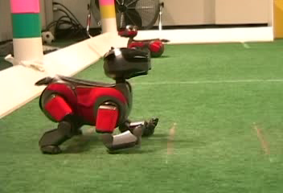
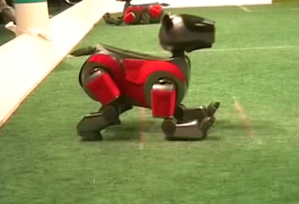
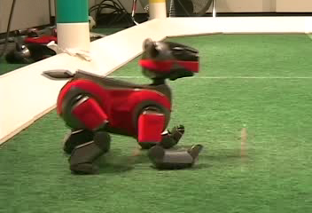
Example: Learning to Walk
Initial
A Learning Trial
After Learning [1K Trials]
[Kohl and Stone, ICRA 2004]

Slide 11

Example: Learning to Walk
Initial
[Kohl and Stone, ICRA 2004]
[Video: AIBO WALK – initial]

Slide 12

Example: Learning to Walk
Training
[Kohl and Stone, ICRA 2004]
[Video: AIBO WALK – training]

Slide 13

Example: Learning to Walk
Finished
[Kohl and Stone, ICRA 2004]
[Video: AIBO WALK – finished]

Slide 14
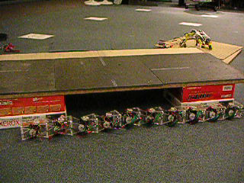
Example: Sidewinding
[Andrew Ng]
[Video: SNAKE – climbStep+sidewinding]

Slide 15

Example: Toddler Robot
[Tedrake, Zhang and Seung, 2005]
[Video: TODDLER – 40s]

Slide 16
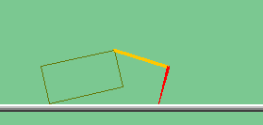
The Crawler!
[Demo: Crawler Bot (L10D1)] [You, in Project 3]
Notes:
At times no reward accumulated at all, just sitting still

Slide 17

Video of Demo Crawler Bot

Slide 18
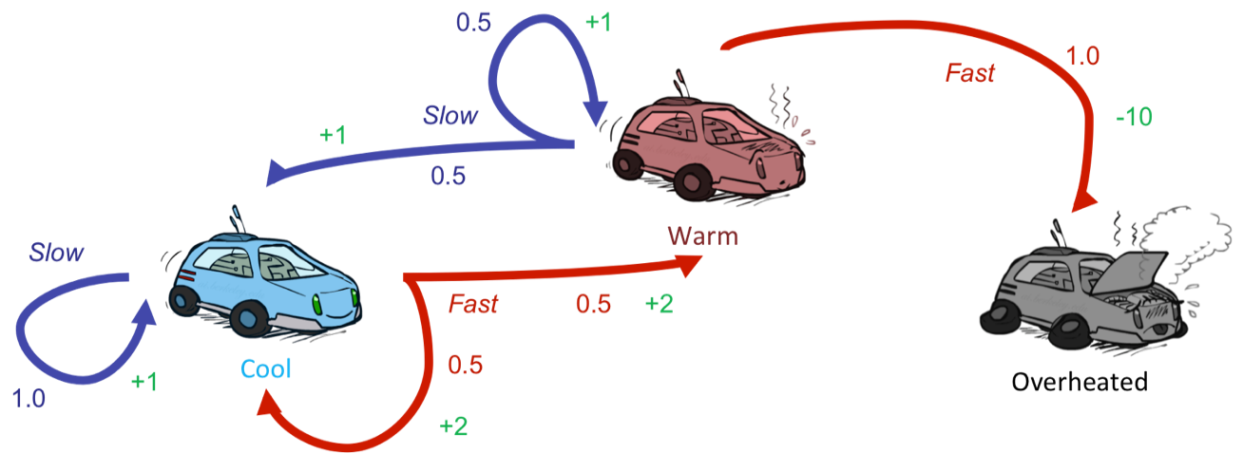
Reinforcement Learning
Still assume a Markov decision process (MDP):
A set of states s ∈ S
A set of actions (per state) A
A model T(s,a,s’)
A reward function R(s,a,s’)
Still looking for a policy π(s)
New twist: don’t know T or R
I.e. we don’t know which states are good or what the actions do
Must actually try actions and states out to learn

Slide 19
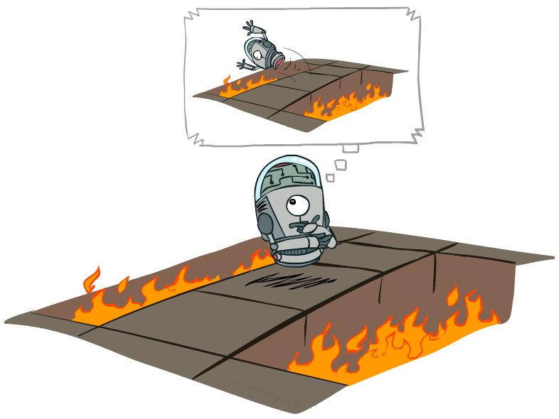
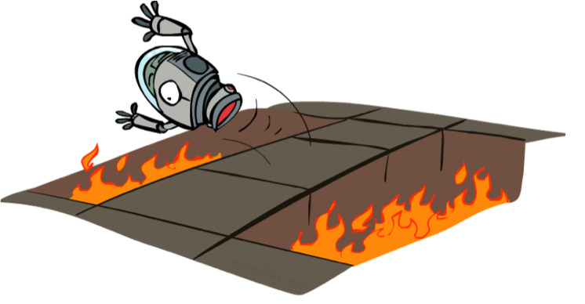
Offline (MDPs) vs. Online (RL)
Offline Solution
Online Learning

Slide 20
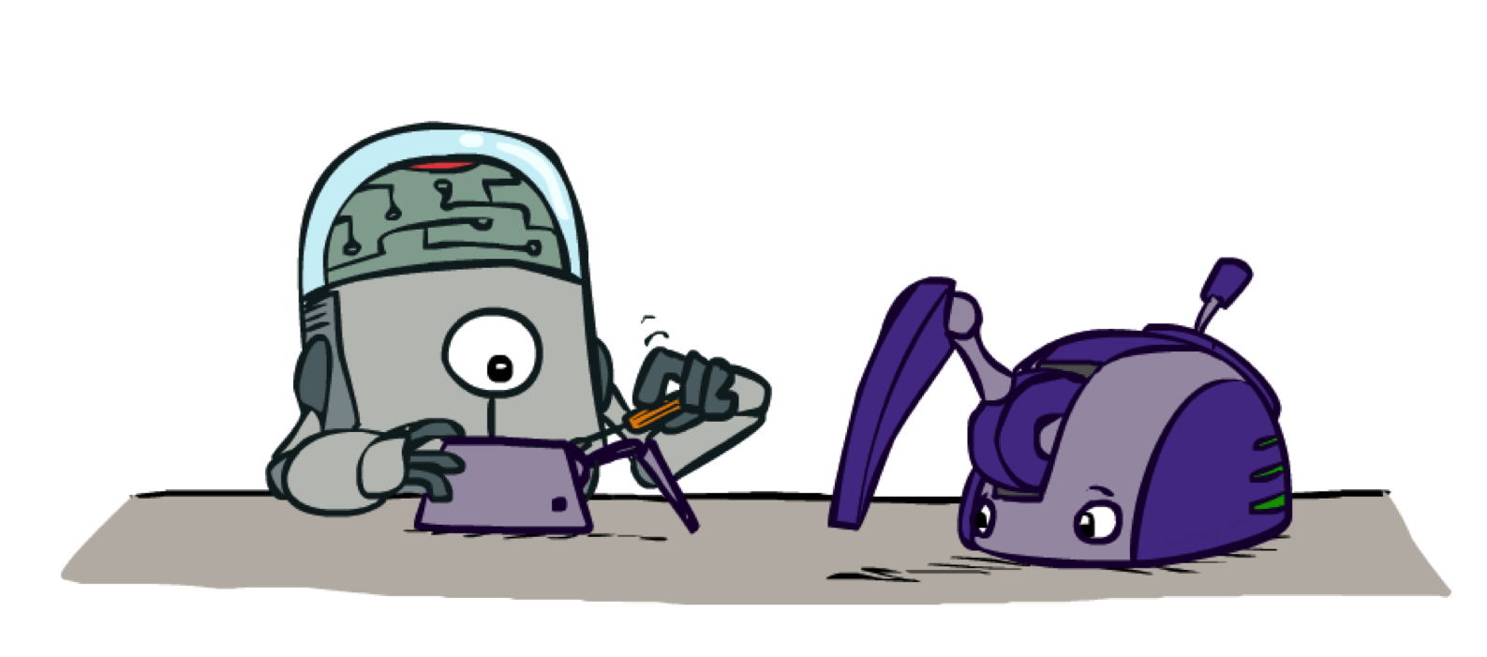
Model-Based Learning

Slide 21

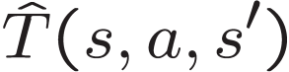

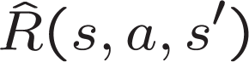
Model-Based Learning
Model-Based Idea:
Learn an approximate model based on experiences
Solve for values as if the learned model were correct
Step 1: Learn empirical MDP model
Count outcomes s’ for each s, a
Normalize to give an estimate of
Discover each when we experience (s, a, s’)
Step 2: Solve the learned MDP
For example, use value iteration, as before

Slide 22
Example: Model-Based Learning
Input Policy π
Observed Episodes (Training)
Learned Model
Episode 1
Episode 2
T(s,a,s’).
T(B, east, C) = 1.00
T(C, east, D) = 0.75
T(C, east, A) = 0.25
…
R(s,a,s’).
R(B, east, C) = -1
R(C, east, D) = -1
R(D, exit, x) = +10
…
 | A
B | C | D
 | E
B, east, C, -1
C, east, D, -1
D, exit, x, +10
B, east, C, -1
C, east, D, -1
D, exit, x, +10
Episode 3
Episode 4
E, north, C, -1
C, east, D, -1
D, exit, x, +10
E, north, C, -1
C, east, A, -1
A, exit, x, -10
Assume: γ = 1

Slide 23
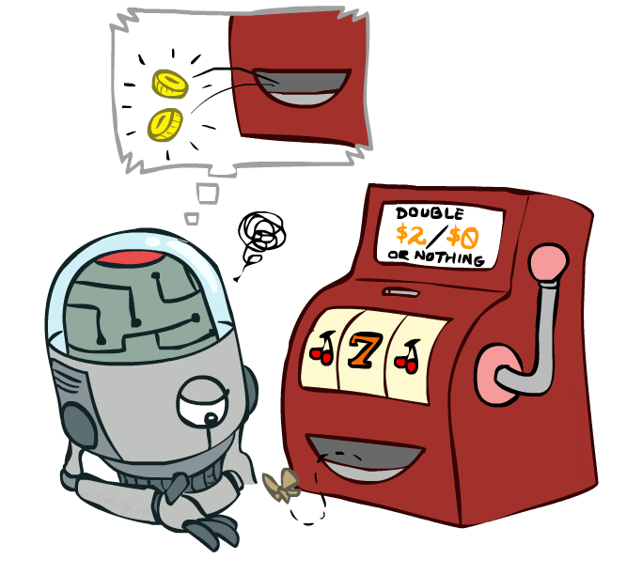
Model-Free Learning

Slide 24
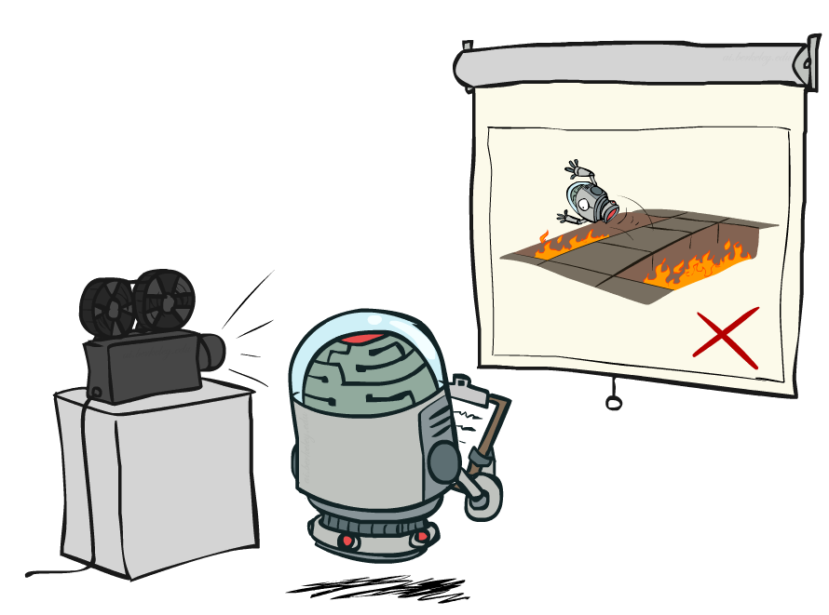
Passive Reinforcement Learning

Slide 25

Passive Reinforcement Learning
Simplified task: policy evaluation
Input: a fixed policy π(s)
You don’t know the transitions T(s,a,s’)
You don’t know the rewards R(s,a,s’)
Goal: learn the state values
In this case:
Learner is “along for the ride”
No choice about what actions to take
Just execute the policy and learn from experience
This is NOT offline planning! You actually take actions in the world.

Slide 26
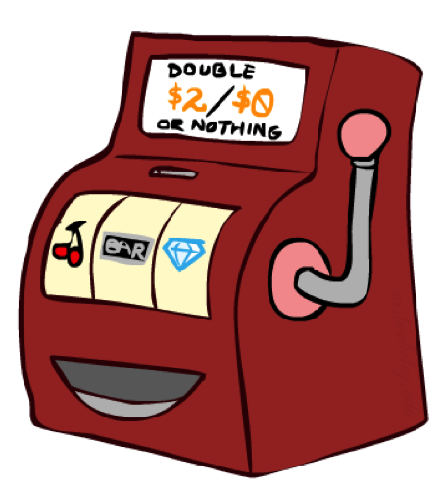
Direct Evaluation
Goal: Compute values for each state under π
Idea: Average together observed sample values
Act according to π
Every time you visit a state, write down what the sum of discounted rewards turned out to be
Average those samples
This is called direct evaluation

Slide 27
Example: Direct Evaluation
Input Policy π
Observed Episodes (Training)
Output Values
Episode 1
Episode 2
 | A
B | C | D
 | E
 | A
B | C | D
 | E
B, east, C, -1
C, east, D, -1
D, exit, x, +10
B, east, C, -1
C, east, D, -1
D, exit, x, +10
-10
+8
+4
+10
Episode 3
Episode 4
-2
E, north, C, -1
C, east, D, -1
D, exit, x, +10
E, north, C, -1
C, east, A, -1
A, exit, x, -10
Assume: γ = 1

Slide 28
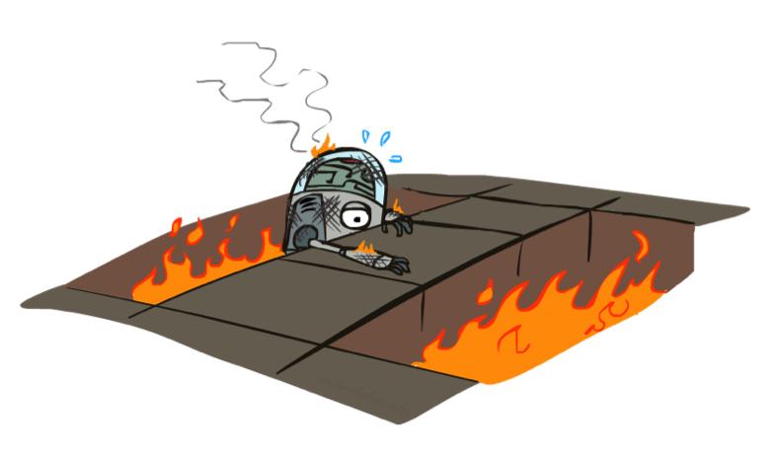
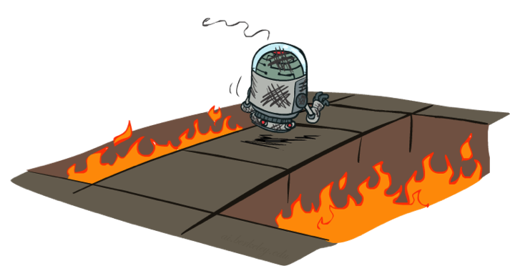
Active Reinforcement Learning

Slide 29
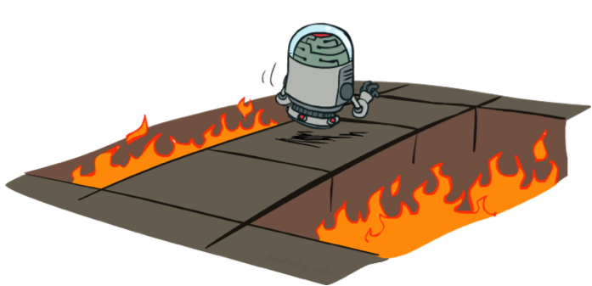
Active Reinforcement Learning
Full reinforcement learning: optimal policies (like value iteration)
You don’t know the transitions T(s,a,s’)
You don’t know the rewards R(s,a,s’)
You choose the actions now
Goal: learn the optimal policy / values
In this case:
Learner makes choices!
Fundamental tradeoff: exploration vs. exploitation
This is NOT offline planning! You actually take actions in the world and find out what happens…

Slide 30
Q-Learning
Q-learning is an off policy reinforcement learning algorithm that seeks to find the best action to take given the current state. It’s considered off-policy because the q-learning function learns from actions that are outside the current policy, like taking random actions, and therefore a policy isn’t needed. More specifically, q-learning seeks to learn a policy that maximizes the total reward.
The ‘q’ in q-learning stands for quality. Quality in this case represents how useful a given action is in gaining some future reward.

Slide 31
Q-Learning
When q-learning is performed we create what’s called a q-table or matrix that follows the shape of [state, action]
we initialize our values to zero.
We then update and store our q-values after an episode.
This q-table becomes a reference table for our agent to select the best action based on the q-value.
The next step is simply for the agent to interact with the environment and make updates to the state action pairs in our q-table Q[state, action].

Slide 32
Taking Action: Explore or Exploit
An agent interacts with the environment in 1 of 2 ways.
The first is to use the q-table as a reference and view all possible actions for a given state.
The agent then selects the action based on the max value of those actions.
This is known as exploiting since we use the information we have available to us to make a decision.
The second way to take action is to act randomly.
This is called exploring.
Instead of selecting actions based on the max future reward we select an action at random.
Acting randomly is important because it allows the agent to explore and discover new states that otherwise
may not be selected during the exploitation process.
You can balance exploration/exploitation using epsilon (ε) and setting the value of how often you want to explore vs exploit.

Slide 33
Updating the q-table
The updates occur after each step or action and ends when an episode is done.
Done in this case means reaching some terminal point by the agent.
A terminal state for example can be anything like landing on a checkout page,
reaching the end of some game, completing some desired objective, etc.
The agent will not learn much after a single episode, but eventually with
enough exploring (steps and episodes)
it will converge and learn the optimal q-values or q-star (Q∗).

Slide 34
Q-Learning
Here are the 3 basic steps:
Agent starts in a state (s1) takes an action (a1) and receives a reward (r1)
Agent selects action by referencing Q-table with highest value (max) OR by random (epsilon, ε)
Update q-values

Slide 35
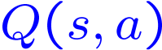
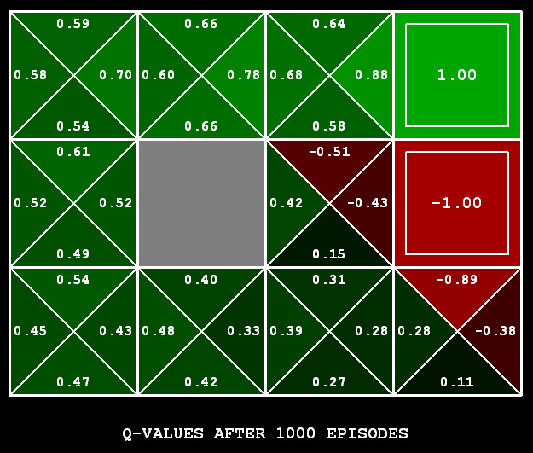
Q-Learning
Q-Learning: sample-based Q-value iteration
Learn Q(s,a) values as you go
Receive a sample (s,a,s’,r)
Consider your old estimate:
Consider your new sample estimate:
Incorporate the new estimate into a running average:
[Demo: Q-learning – gridworld (L10D2)]
[Demo: Q-learning – crawler (L10D3)]

Slide 36
Video of Demo Q-Learning -- Gridworld

Slide 37
Video of Demo Q-Learning -- Crawler

Slide 38

Q-Learning Properties
Amazing result: Q-learning converges to optimal policy -- even if you’re acting suboptimally!
This is called off-policy learning
Caveats:
You have to explore enough
You have to eventually make the learning rate
small enough
… but not decrease it too quickly
Basically, in the limit, it doesn’t matter how you select actions (!)

Slide 39
Conclusion
Reinforcement learning addresses a very broad and relevant question:
How can we learn to survive in our environment?
We have looked at Q-learning, which simply learns from experience.
No model of the world is needed.
We made simplifying assumptions: e.g. state of the world only depends on
last state and action. This is the Markov assumption. The model is called
a Markov Decision Process (MDP).
We assumed deterministic dynamics, reward function, but the world really is
stochastic.
There are many extensions to speed up learning.
There have been many successful real world applications.
http://elsy.gdan.pl/index.php?option=com_content&task=view&id=20&Itemid=39

